Slide 1
Improving scalability of Recommender Systems
NIKUNJ RANA

Slide 2

Introduction
Scalability in collaborative filtering is challenged by growing user-item interactions
Critical to handle the ever-increasing volume of user data for service efficiency

Slide 3
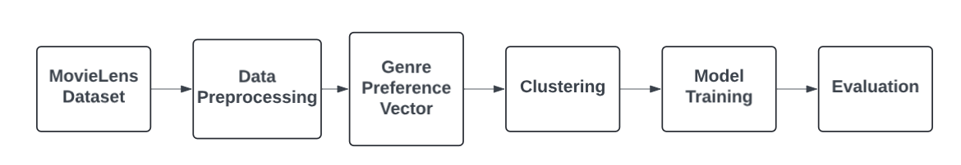
Baseline

Slide 4

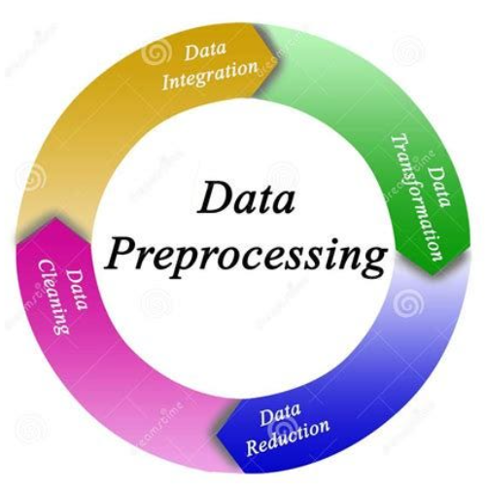

Data
USER_ID
MOVIE_ID
RATING
TIMESTAMP
Movies
Movie_ID
TITLE
GENRES
Users
GENRE PREPROCESSING
MERGING & FILTERING DATA

Slide 5
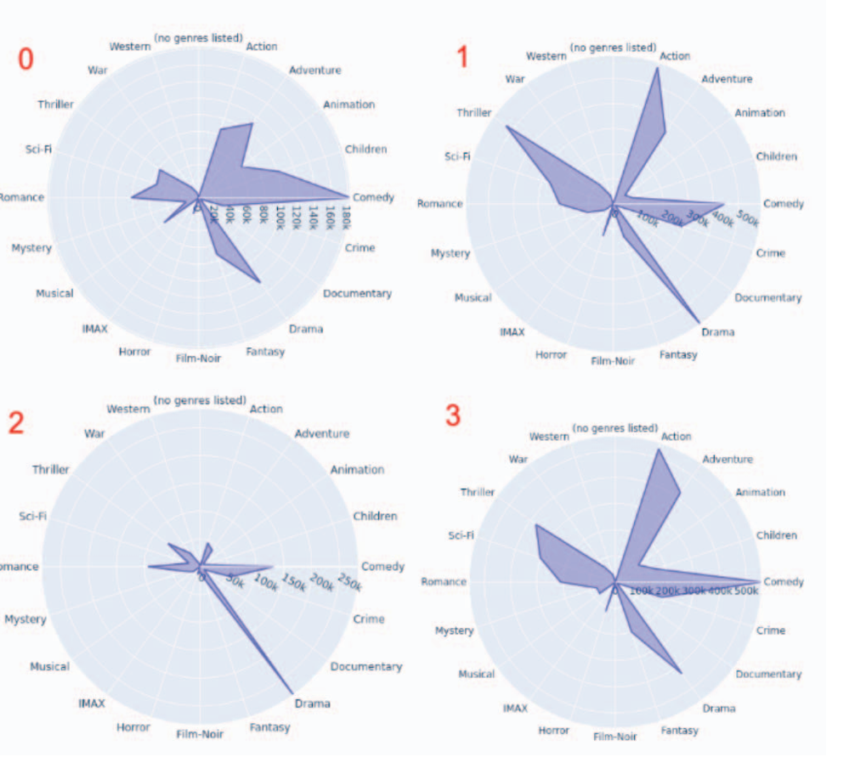
Clustering Methods
K-Means
Mini Batch K-Means
BIRCH
Agglomerative Clustering,
OPTICS
DBSCAN

Slide 6
Model Training Methods
K-nn
SVD
SVD++

Slide 7
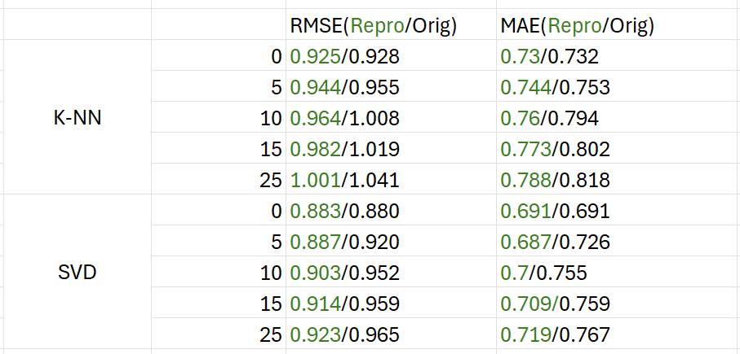
Baseline Reproduction Results(Error metric)
Notes:
SVD++ need to perform.

Slide 8
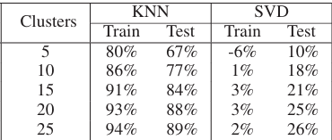
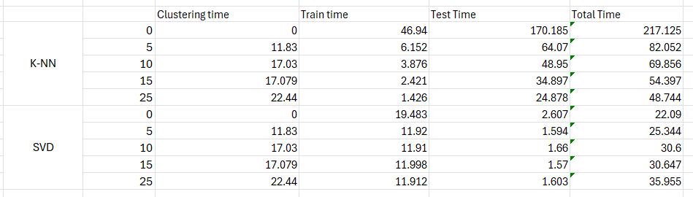
Baseline Reproduction Results(Time)
Notes:
SVD++ need to perform.

Slide 9
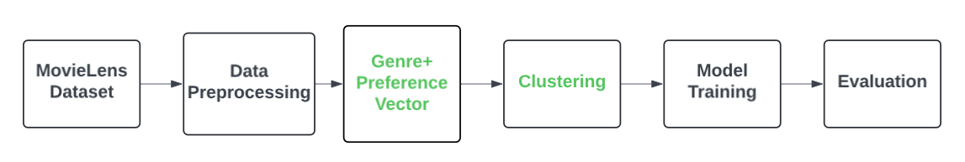
Proposed Solution

Slide 10
Genre+ Preference Vector
Drawback Of Genre vector:
User with ratings below 3.5 wont get clustered.(2 users in our dataset)

Slide 11
Genre+ Preference Vector
Two methods proposed:
No filtering: Just focus on the genre user is interested in.
Double filtering: First filter with the user rating > 3.5 and then user rating < 2 and combine the results.

Slide 12
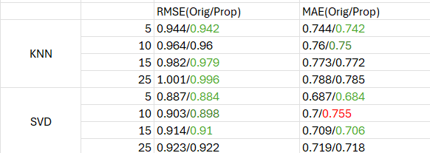
No Filtering

Slide 13
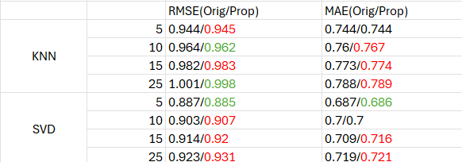
Double Filtering

Slide 14
Clustering methods:
Hierarchical Clustering
HDBSCAN (Hierarchical DBSCAN)
GMM(Gaussian Mixture Model)

Slide 15
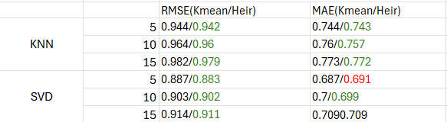
Hierarchical Clustering result

Slide 16
Conclusion
The Genre+ vector approach has shown to be more effective but it has drawbacks too.
Implementing hierarchical clustering has yielded improved results.
While the current clustering approach may slightly reduce accuracy, it's crucial to find the optimal trade-off between computational time and precision.

Slide 17
Thank you.

